Slide 1
“The Law”
How God Remedied The Defects of the Law
LIFE
&
RIGHTEOUSNESS
(part 4c, section 2)
All verses are from the New King James Version unless noted.

Slide 2
Previously
God’s Remedy To Impart Life And Righteousness Apart From The Law
  Romans 8:1-4

Slide 3
Currently
God’s Remedy To Impart Life And Righteousness Apart From The Law
  Romans 8:1-4
  Ephesians 1:6, 7

Slide 4
Ephesians 1:6, 7
“to the praise of the glory of His grace, by which He has made us accepted in the Beloved.
In Him we have redemption through His blood, the forgiveness of sins, according to the riches of His grace”
The Father
The Son
In our adoption (v. 5)
We cannot overemphasize the need to be “IN HIM” (cf. v. 3, 4, 10, 11)

Slide 5
Ephesians 1:6, 7
“to the praise of the glory of His grace, by which He has made us accepted in the Beloved.
In Him we have redemption through His blood, the forgiveness of sins, according to the riches of His grace”
A release/deliverance upon payment
Jehovah has personally invested Himself in Man!

Slide 6
Redemption = Payment
Exodus 21:29, 30
²⁹ "But if the ox tended to thrust with its horn in times past, and it has been made known to his owner, and he has not kept it confined, so that it has killed a man or a woman, the ox shall be stoned and its owner also shall be put to death.
³⁰ "If there is imposed on him a sum of money, then he shall pay to redeem his life, whatever is imposed on him.

Slide 7
Redemption
Exodus 6:6, 7
⁶ "Therefore say to the children of Israel: ‘I am the LORD; I will bring you out from under the burdens of the Egyptians, I will rescue you from their bondage, and I will redeem you with an outstretched arm and with great judgments.
⁷ ‘I will take you as My people, and I will be your God. Then you shall know that I am the LORD your God who brings you out from under the burdens of the Egyptians.
Work
Effect
BRING
RESCUE
REDEEM
TAKE YOU
BE YOUR
Notes:
In the five times Jehovah states “I will,” we see the template of redemption. We see the work of redemption and its desired effect. God would redeem Israel by bringing them out from “under” something, viz., the burden of the Egyptians. This was a “rescue” from bondage which is the work of redemption with an outstretched arm. Note that when God redeems He brings men out from under something and he rescues them from something. There is a payment of something as well. It may be a payment of an outstretched arm and also with judgment.
The effect of this is God investing himself with man, that is, the taking of man to be his people and the “giving” of himself to the people as their God. One might say in taking man, God is giving himself to and for man. This is seen in “I will be your God.” This foreshadows the work of Jehovah in the New Testament. Please note carefully that we see a glimpse into the heart of our great God. He is a loving God who sees something valuable in man and desires his company.

Slide 8
Redemption
Titus 2:13, 14
13 looking for the blessed hope and glorious appearing of our great God and Savior Jesus Christ,
14 who gave Himself for us, that He might redeem us from every lawless deed and purify for Himself His own special people, zealous for good works.
“and have taken you to Me for a people, and I have been to you for God,” (Ex. 6:7, YLT)
Work
Effect
BRING
RESCUE
REDEEM
TAKE YOU
BE YOUR
Notes:
He redeemed us so that He could take us to be His own special people and so that He can be a God to us.

Slide 9
If We Are Redeemed…
It implies that we:
  Were “under” the burden of something
  Were in need to be “rescued” from something
SIN
DEVIL
LAW
Rom. 6:14, 15
Gal. 3:22; Rom. 3:9
2 Tim. 2:26
MAN
DEATH
DEATH
(Ezekiel 18:4; Romans 3:23; 6:23)

Slide 10
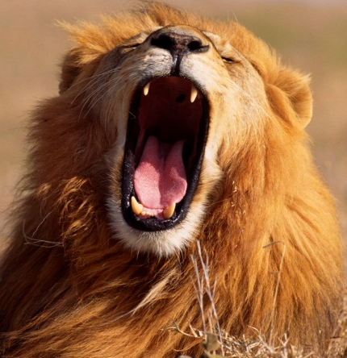
Example: Daniel in the Den of Lions
Law was to not petition any god or man for 30 days except the king (Dan. 6:7)
Petitioned the true God as was his custom (Dan. 6:10)
Was cast into the den/power of lions (Dan. 6:11-16a)
LIONS
LAW
DANIEL
DEATH
DEATH

Slide 11
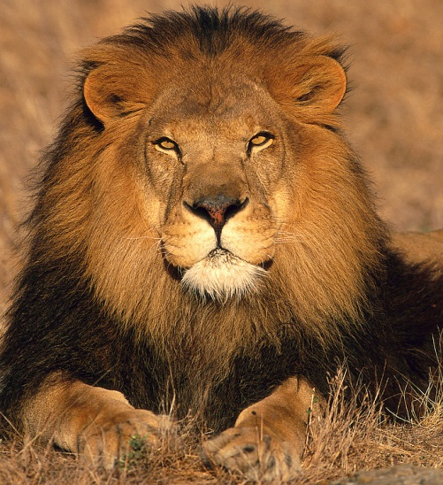
Example: Daniel in the Den of Lions
Delivered from the law that condemned him BUT not by an earthly king (Dan. 6:14)
By faith in God, “…‘Your God, whom you serve continually, He will deliver you.’” (Dan. 6:16, see 6:23)
Was righteous and therefore found alive through grace (Dan. 6:22; Ezek. 14:14)
DANIEL
Delivered
Delivered
LIONS
LAW

Slide 12
Jesus Redeems Us!
In Christ, God:
  Made us sufficient as ministers of the new covenant (2 Cor. 3:6)
  Made us free (Gal. 5:1)
  Made us accepted (Eph. 1:6)
  Made us alive (Eph. 2:5)
  Made us sit together in the heavenly places (Eph. 2:6)
MAN
Alive
Alive
SIN
DEVIL
LAW
Rom. 6:14, 15
Gal. 3:22; Rom. 3:9
2 Tim. 2:26
Notes:
He brings us out from under the law to under grace. He brings us out from under sin to being made righteous. He brings us out from being kidnapped by Satan, to being set free.

Slide 13
How Did Jesus Redeems Us?
“But of Him you are in Christ Jesus, who became for us wisdom from God—and righteousness and sanctification and redemption—that, as it is written, ‘He who glories, let him glory in the LORD’” (1 Cor. 1:30, 31)
Through His blood!
MAN
Alive
Alive
SIN
DEVIL
LAW
Rom. 6:14, 15
Gal. 3:22; Rom. 3:9
2 Tim. 2:26

Slide 14
Ephesians 1:6, 7
“to the praise of the glory of His grace, by which He has made us accepted in the Beloved.
In Him we have redemption through His blood, the forgiveness of sins, according to the riches of His grace”
Only one acceptable ransom price—the life blood of God
When Jesus shed His blood, He gave his life for us (Lev. 17:11; Matt. 20:28; 26:28; Acts 20:28; Gal. 3:13; etc.)

Slide 15
How Did Jesus Redeems Us?
Through His blood!
Through the Faith!
THE FAITH
In His BLOOD
“Whom God did set forth a mercy seat, through the faith in his blood, for the shewing forth of His righteousness, because of the passing over of the bygone sins in the forbearance of God — for the shewing forth of His righteousness in the present time, for His being righteous, and declaring him righteous who is of the faith of Jesus” (Rom. 3:25, 26, YLT)

Slide 16
“The Faith In His Blood”
Provides us a “mercy seat”
Displays the righteousness of God
Declares those of “the faith” as righteous and gives them life (cf. Rom. 6:23)
Is “the gospel” (Rom. 1:16, 17)
THE FAITH
In His BLOOD
“Whom God did set forth a mercy seat, through the faith in his blood, for the shewing forth of His righteousness, because of the passing over of the bygone sins in the forbearance of God — for the shewing forth of His righteousness in the present time, for His being righteous, and declaring him righteous who is of the faith of Jesus” (Rom. 3:25, 26, YLT)

Slide 17
Baptism is an Essential Part of The Saving Gospel to Obtain Life and Righteousness!
Gospel preached includes baptism (Mk. 16:15, 16)
Baptism is the entrance into Christ (Rom. 6:3)
Baptism contacts us to His death (Rom. 6:3, 4)
  Contacts His blood which was shed in death!

Slide 18
Ephesians 1:6, 7
“to the praise of the glory of His grace, by which He has made us accepted in the Beloved.
In Him we have redemption through His blood, the forgiveness of sins, according to the riches of His grace”
Baptism is “in Him,” therefore we are not accepted until baptized
Baptism is “in Him,” therefore we are not redeemed through His blood until we are baptized
Baptism is “in Him,” therefore we are not forgiven of sins until we are baptized
Baptism is “in Him,” therefore we are not saved according to grace until we are baptized

Slide 19
Does Baptism Therefore Connect Us With Life and Righteousness?
Recall: Sin reigns through death (Rom. 5:21)
Grace reigns through righteousness unto eternal life by Jesus Christ (Rom. 5:21)
When we are buried and raised with Christ in baptism, we are:
  To walk in newness of life (Rom. 6:4, 5)
    If it connects us to “life,” it MUST connect us to “righteousness!”
    Righteousness and grace must be there (Rom. 5:21)
    Hence we are to be living as God’s just ones (5:21)
  Freed from sin (Rom. 6:6, 7, 11-14)
“Now if we died with Christ, we believe that we shall also live with Him” (Rom. 6:8)

Slide 20
Some Final Thoughts
Sin leads to death and obedience leads to righteousness (Rom. 6:16)
  Righteousness must impart “life” for it to be the cure for sin and death
  Obedience leads to righteousness
  Baptism is an act of obeying Christ (Mk. 16:16)
  Therefore baptism leads to righteousness (1 Cor. 6:11)
    Imparting life (Rom. 6:4)
    Pardoning sin (Acts 2:38; 22:16)

Slide 21
Slaves of Sin
Rom. 6:20
Free From Righteousness
Rom. 6:20
Fruit = Ashamed
Rom. 6:21
Death
Rom. 6:21

Slide 22
Obeyed From the Heart in baptism (6:3, 17)
Set free from sin, slaves of R. (Rom. 6:18)
Fruit to Holiness (Rom. 6:22)
End = E. life (Rom. 6:22, 23)

